Slide 1
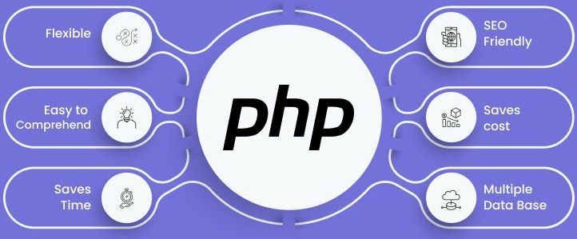

Slide 2
About today…
State Management
Session

Slide 3
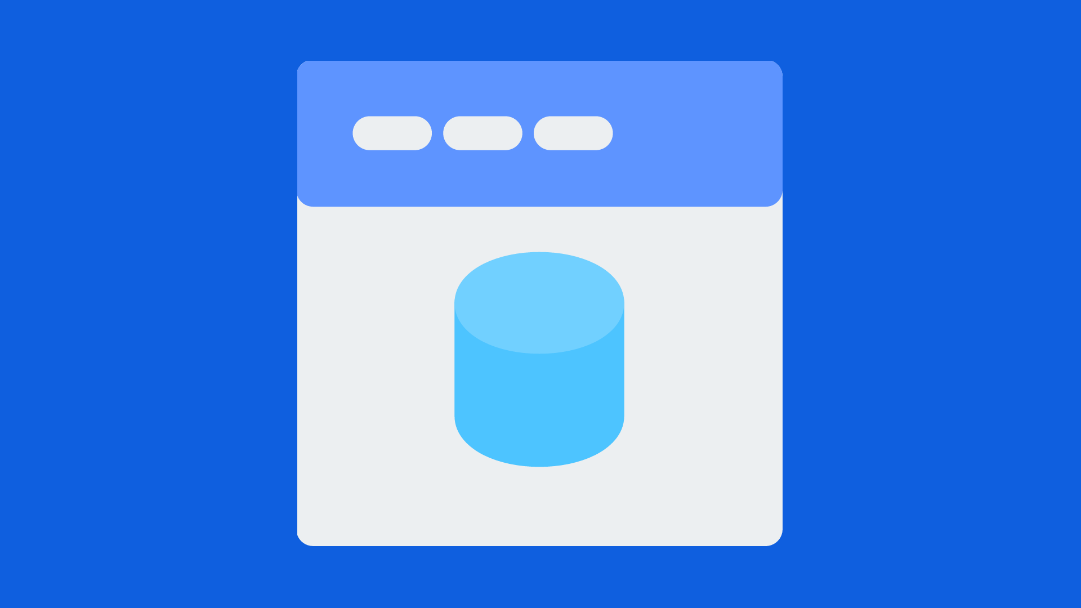
Sessions

Slide 4
Introduction to Sessions
Definition
Sessions are a way to store information (in variables) to be used across multiple pages
Importance
Unlike cookies, session variables are stored on the server and are not limited in size

Slide 5
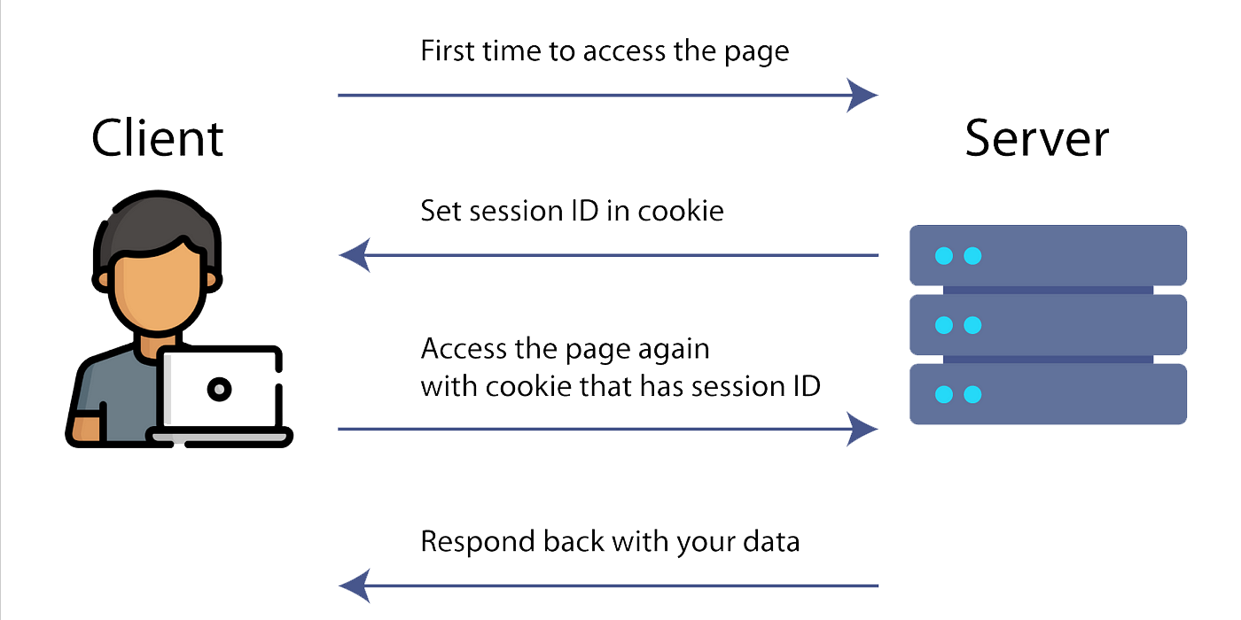
Starting a Session
Diagram
Explanation
When a session is started, a unique session ID is created and sent to the client in a cookie or via URL

Slide 6

Starting a Session
Code Example
Explanation
The session_start() function must be the first thing in your document. It initializes a new session or resumes an existing session

Slide 7

Storing Session Variables
Code Example
Explanation
Session variables are stored in the $_SESSION superglobal array

Slide 8

Accessing Session Variables
Code Example
Explanation
Access session variables using the $_SESSION superglobal array.

Slide 9

Modifying Session Variables
Code Example
Explanation
You can modify a session variable by reassigning it a new value.

Slide 10

Unsetting Session Variables
Code Example
Explanation
Use the unset() function to remove a session variable

Slide 11

Destroying a Session
Code Example
Explanation
The session_destroy() function destroys all data registered to a session

Slide 12

Regenerating Session ID
Code Example
Explanation
The session_regenerate_id(true) function creates a new session ID, helping to prevent session fixation attacks

Slide 13

Session Configuration
Settings
Configuring session behavior via php.ini
Examples
session.cookie_lifetime: Lifetime of the session cookie
session.gc_maxlifetime: Time-to-live for session data on the server
Code Example
Explanation
These settings control the duration and garbage collection of sessions

Slide 14
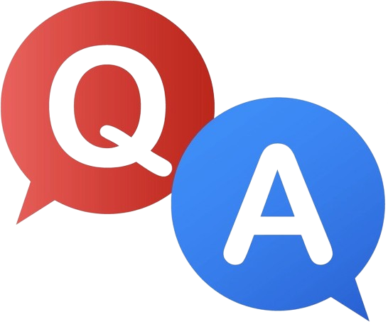

Slide 15

What is a session in PHP?
A way to store data across multiple pages on the server
Which function is used to start a session in PHP?
session_start()
How do you store a value in a session variable?
$_SESSION["key"] = "value";
Which function is used to destroy all data associated with a session?
session_destroy()

Slide 16

Task 1
Practice starting a session, setting session variables, and accessing them

